Slide 1

Eye Guide
Supervised by:
Dr: Salsabil Amin
TA: Mona Sadik

Slide 2
Team Members
David Maged
Joseph Ezzat
Ibrahim Sayed
Haya Hesham
Marlyien Magdy
At Computer Science Department

Slide 3

Agenda
Problem Definition
Motivation
Objective
Related Work
System Architecture & phases Description
Datasets
Time Plan
Tools

Slide 4

Problem Definition

Slide 5

Problem Definition
According to the world blind union, there are about 253 million people around the world with serious vision problems.
There are about 47 million of them who are blind.
Visually impaired people can sense light and shadows only and cannot see objects in front of them.

Slide 6
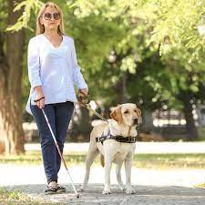
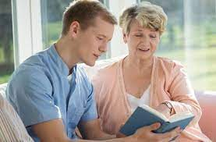

Problem Definition
Visual impaired and blind people frequently do not detect or recognize outdoor obstacles.
They need guidance to avoid risks.
Eye Guide will help the visually impaired and the blind people in an outdoor environment without depending on other people.

Slide 7

Motivation

Slide 8
Help them enjoy their life.
Help them to be more independent.
Help them navigate outdoors safely.
Relieving them from feeling that they are burdens on other people or family members all the time.
Motivation

Slide 9
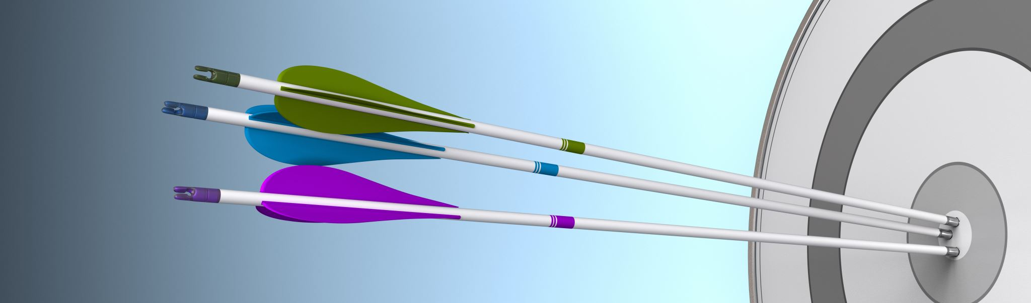
Objective

Slide 10
Build an Android application with these features.
Face recognition feature to help them recognize familiar people.
Currency recognition feature to be able pay at any market.
Speech recognition feature to help communicating with them
Guidance feature to help them navigate outdoors safely.
Objective
Predict the distance in feet between them and obstacles to help them avoid colliding with it.
Guide them to their destination by calculating a safe path in feet with directions.
Detect and recognize obstacles at outdoors environments.
Such as: Cars, Trees, Stairs, motorbikes, Traffic Lights, etc

Slide 11
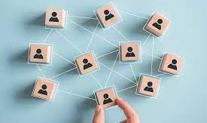
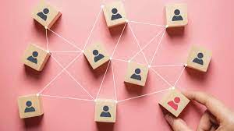
Related work
Survey
Related Applications

Slide 12

1.Survey
(Google Form)

Slide 13
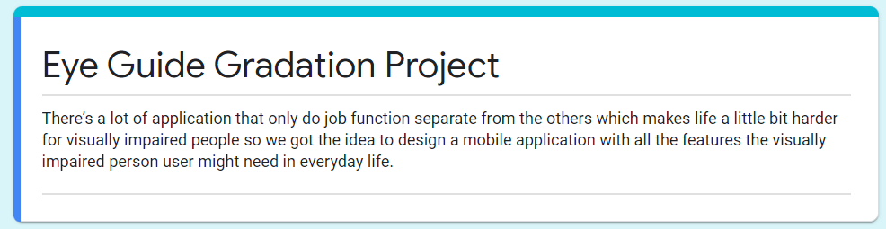
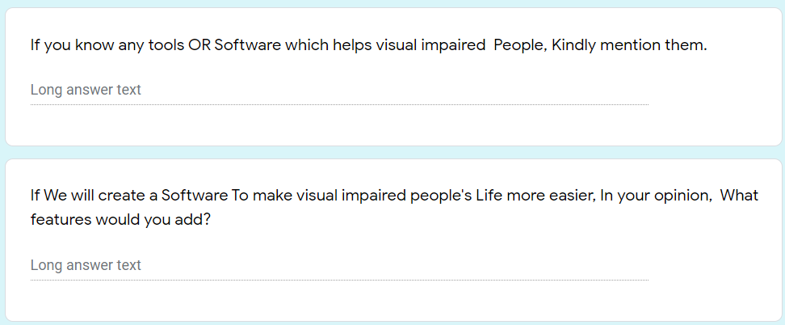
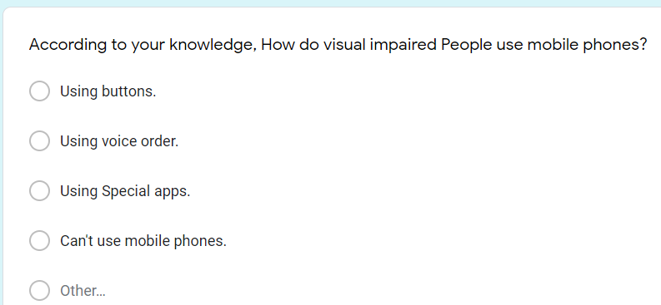
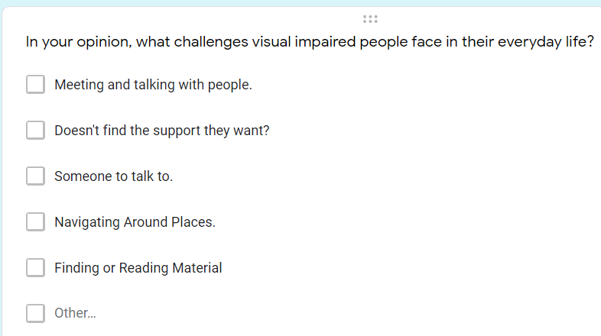
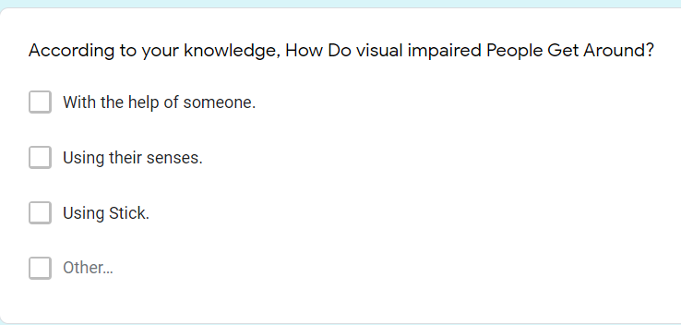
Google Form
Overview

Slide 14
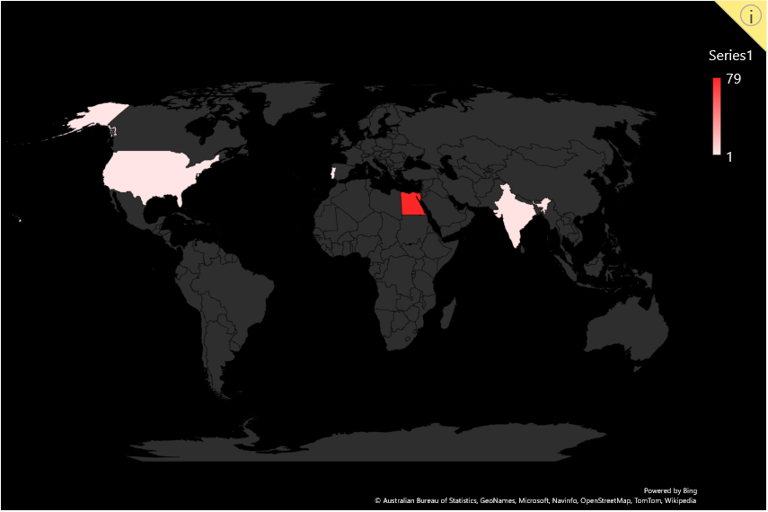
Survey Responses
5 Countries
+ 90 response
Survey Link
Egypt (79 )
India (3)
USA (2)
Canada, England (2)
Portugal (1)

Slide 15
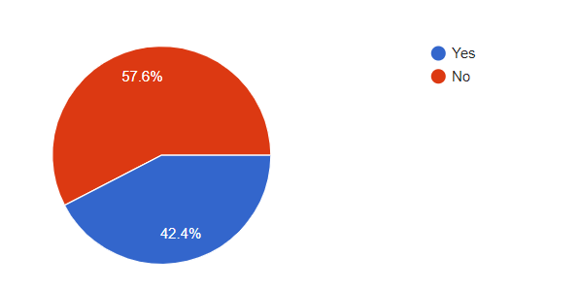
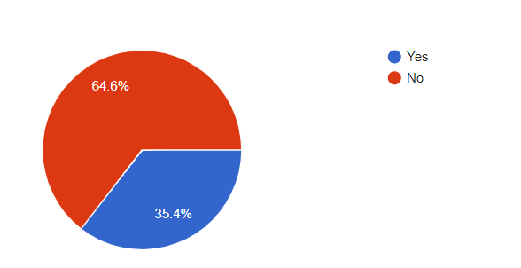
Do you know a visually impaired person?
Does he/she use some software application to help make life easier?

Slide 16
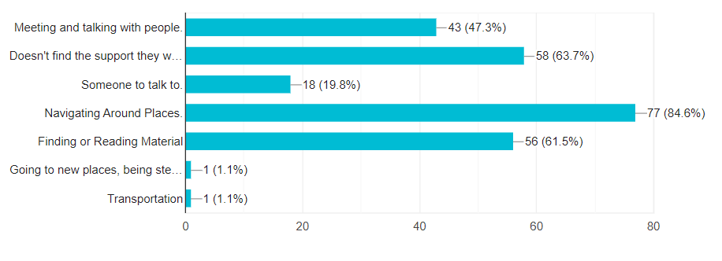
In your opinion, what challenges do visually impaired people face in their everyday life?

Slide 17
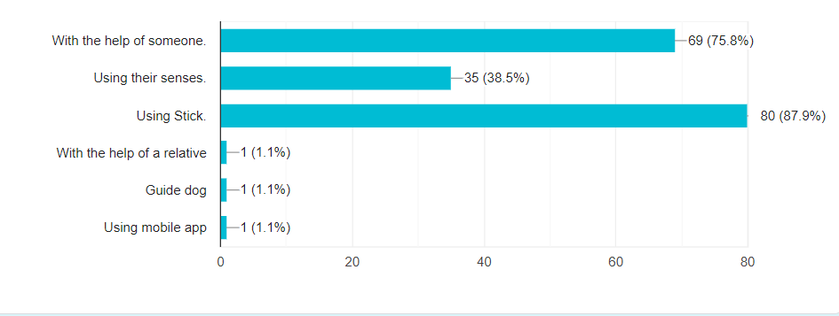
According to your knowledge, How Do visually impaired People Get Around?

Slide 18
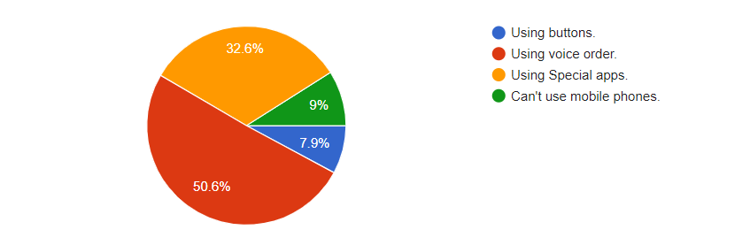
According to your knowledge, How do visually impaired People use mobile phones?

Slide 19
Survey results benefits
84.6 % of blinds are facing problems while navigating around places.
63.7 % of blinds don’t find support they want.
88 % of blinds are getting around using stick
75.8 % of blinds are getting around with the help of others.
32.6% Of blinds are use special apps to help them.

Slide 20


2.Real-life applications built especially for blind and visually impaired people

Slide 21

Related Apps
Be my eyes:
It’s a free mobile app that connects blind and visually impaired people with sighted volunteers and companies from all over the world through a live video call.
Aipoly Vision:
A free mobile app contains object-and-color recognizer features.

Slide 22


Features | Be My Eyes | Aipoly Vision | Eye Guide (Proposed)
Video Call
Object Recognition
Face Recognition
Currency Recognition
Obstacles Detection
Distance Prediction
Guide the user
Speech Recognition
Features comparison between existing application and our proposed application

Slide 23

System Architecture

Slide 24
System Architecture
Video acquisition and extract # of frames
Filter & Analyze each frame
Detect objects in the filtered frame
Recognize the objects
Take instructions from the user
Calculate the distance between the user and objects in feet
Warn the user if there is a near obstacle
Decide the best route for reaching the determined destination

Slide 25
Object Detection model takes an image as input and using (CNN), image label is returned.
Object recognition model takes an image label as input and using CNN, it recognizes the objects.
Distance estimation will be done using CNN.
Obstacles models takes an object recognized list as input and detect whether the obstacles on user way or not.
Choose instruction will let the user choose between describing the scene or guiding him (Using Google API).
Phases
Description

Slide 26
Currency Recognition: can be recognized using
Size
color
symbol
text
Face recognition feature:
will recognize the photos for people added by the user
let users add other people to be recognized in the future
This feature can add to the online scene.
Tools used: OPENCV
Phases Description (cont.)

Slide 27

Datasets

Slide 28
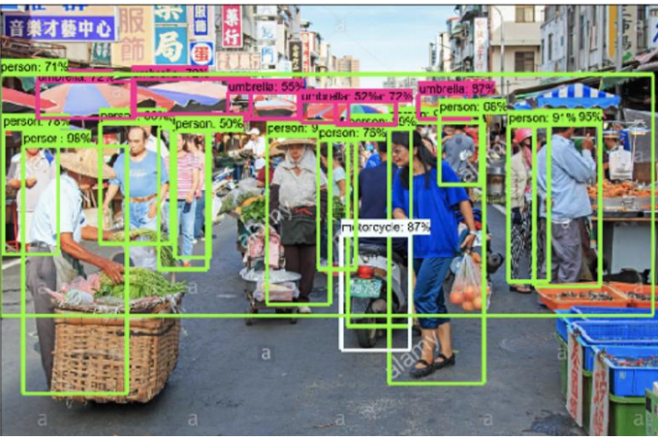
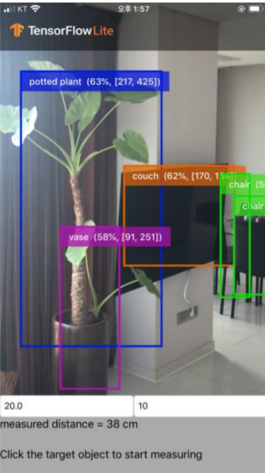
Datasets
Egypt Currency
Published on Kaggle.
Contains +9000 images for Egyptian currency.
Object Detection Dataset.
Published by Google Research.
Contains over +1.5 million images.
+500 category.

Slide 29
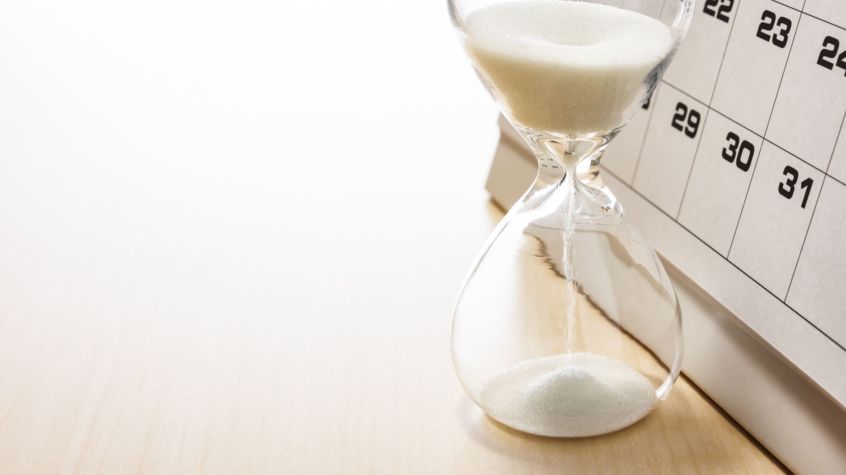
Time Plan

Slide 30
Time Plan
Phase | November | December | January | February | March | April | May | June
Survey on each phase
System Analysis and Design
Phases Implementations and Testing
System Integration and Evaluation
Documentation

Slide 31

Tools

Slide 32




Tools

Slide 33

References

Slide 34
References
Shadi, S., Hadi, S., Nazari, M.A. and Hardt, W., 2019. Outdoor navigation for visually impaired based on deep learning. In Proc. CEUR Workshop Proc (Vol. 2514, pp. 97-406).
Sierra, J.S. and Togores, J., 2012. Designing mobile apps for visually impaired and blind users. In The Fifth international conference on advances in computer-human interactions (pp. 47-52).
Chucai Yi, Yingli Tian, Aries Arditi," Portable Camera-Based Assistive Te and Product Label Reading From Hand-Held Objects for Blind Persons". IEEE/ASME TRANSACTIONS ON MECHATRONICS, vol. 19, NO. 3, June 2014
X. Chen and A. L. Yuille, "Detecting and reading text in natural scenes," in Proc. Compute. Vision Pattern Recognise. 2004, vol. 2, pp. II-366-11-373
K. Kim, K. Jung, and J. Kim, "Texture-based approach for text detection in images using support vector machines and continuously adaptive mean shift algorithm," IEEE Trans. Pattern Anal. Mach. Intel., vol. 25, no. 12,pp. 1631-1639,Dec. 2003.

Slide 35
References (cont.)
Abburu, V., Gupta, S., Rimitha, S.R., Mulimani, M. and Koolagudi, S.G., 2017, August. Currency recognition system using image processing. In 2017 Tenth International Conference on Contemporary Computing (IC3) (pp. 1-6). IEEE.
Redmon, J., Divvala, S., Girshick, R. and Farhadi, A., 2016. You only look once: Unified, real-time object detection. In Proceedings of the IEEE conference on computer vision and pattern recognition (pp. 779-788).
Hansen, D.K., Nasrollahi, K., Rasmussen, C.B. and Moeslund, T.B., 2017. Real-time barcode detection and classification using deep learning. In International Joint Conference on Computational Intelligence (pp. 321-327). SCITEPRESS Digital Library.
Shi, B., Bai, X. and Yao, C., 2016. An end-to-end trainable neural network for image-based sequence recognition and its application to scene text recognition. IEEE transactions on pattern analysis and machine intelligence, 39(11), pp.2298-2304.

Slide 36

Questions?

Slide 37

Thank you

